Slide 1

STATS101C Final Report
LEC 3 Team WDNMD
Eric Ziqi Wang (905198360)
Howell Haoyu Su (505117747)
Jack Yuchen Zhang (405107678)

Slide 2


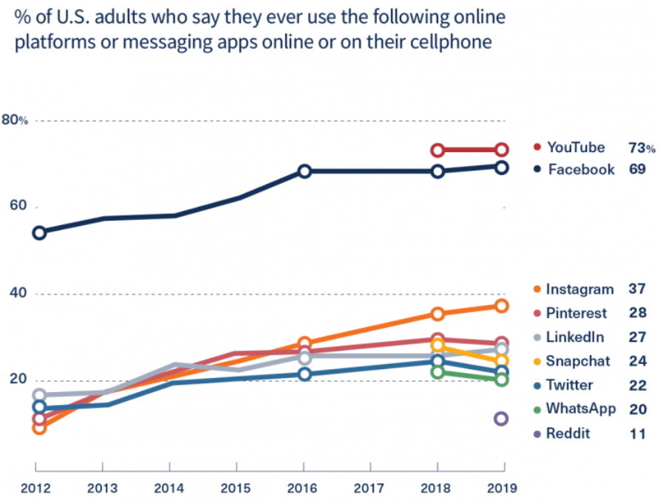
Introduction: Recent success in YouTube online video platform gathers the attention of YouTubers towards its untapped market potential
Background Info
Implication
Started as an online video sharing platform in California, YouTube is now one of the largest video hosting service site in the entire world.
The rapid growth of YouTube prompts the increasing number of content creators. As of 2020, there are over 37 million YouTube channels globally, with an uploading speed of 500 hours of video per minute
Home to over 1.8 billion users worldwide, YouTube possesses 73% active American adult users, making it the most popular online platform among U.S adults.
Increase in competition makes it crucial for the prediction of video views, which is a significant indicator of a channel’s well being

Slide 3
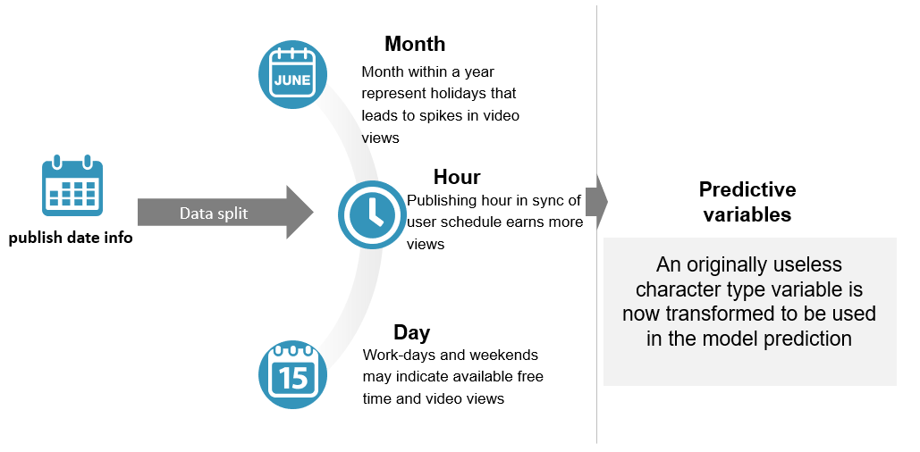
Data Preprocessing: Transforming variables to significant predictors
In order to utilize all available information from the training data, we transformed the publish time information to obtain more prediction power

Slide 4
Random Forest: model explanation and general methodology

Slide 5

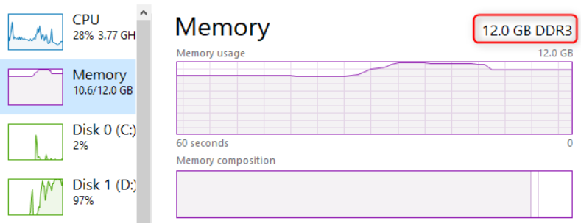


Model Evaluation: Advantages and Weaknesses
Insert MSE and R^2 graph
As can be seen from the comparison graph, Random Forest performs best with highest accuracy
Model Weaknesses
Model Advantages
Random Forest model takes up tons of memory space (RAM)
Random Forest model provides flexibility
Random Forest model predictors selection are hard to interpret
Random Forest model has a high accuracy in prediction (low bias and acceptable variance)

Slide 6
Conclusion: Overall comments and improvement suggestion

